Slide 1

Internship progress weeks 1-3
Data cleaning, survival analysis, signature building, and automation using TOIL COAD datasets
Notes:
Over the last two weeks, I’ve been working with the TOIL pan-cancer dataset to explore CES1 expression in colorectal cancer — specifically colon adenocarcinoma (COAD).
I focused only on primary tumour samples and used clinical metadata from TCGA.
The core aim was to perform survival analysis using gene expression — looking at overall survival, disease-specific survival, and progression-free interval.
After verifying CES1 individually, I built multi-gene signatures by combining CES1 with other genes like CKS1B, BIRC5, and CDCA5.
I also set up automated R pipelines to calculate z-score signatures, apply thresholding, and generate Kaplan–Meier plots.
The diagram here shows the basic flow — starting from expression + clinical CSVs, scaling to signature scores, and then stratifying for survival.”

Slide 2
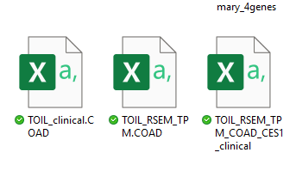
Aim of the last two weeks
Use TOIL pan-cancer datasets to study CES1 and other metabolic genes
Focus on Colon Adenocarcinoma (COAD) samples only
Perform survival analysis (OS, DSS, PFI) using gene expression
Build and test multi-gene signatures
Automate survival pipelines using R scripting
Expression Matrix (.csv)
➕
Clinical Metadata (.csv)
↓
Signature Score (Z-score)
↓
KM Plot (OS / DSS / PFI)
Notes:
The goal was to investigate CES1 expression across COAD samples using survival endpoints like OS, DSS, and PFI. I also built multi-gene signature scores and automated the entire process in R for future scalability. I also did some backround research on why CES1 It's involved in fatty acid metabolism and has been implicated in various cancers which I found fascinating.

Slide 3
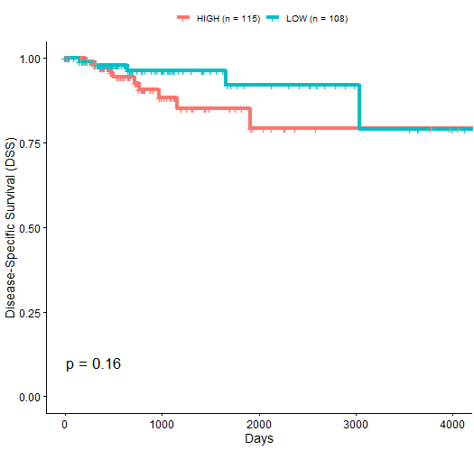
Setup, fixes and survival analysis
Fixed stage-specific filtering
Verified CES1 plots using OS, DSS, and PFI
Added patient counts to legends
Adjusted font sizes and layout
Used correct survival columns (e.g. Os months)
Saved outputs to KM_CES1_plots
On the right is the KM_OS_0.5_v1
Notes:
In Week 1, I focused on verifying and cleaning up the CES1 survival analysis.
I fixed some issues with stage-specific subsetting and made sure I was always using the correct filtered dataset — not the raw file.
I then added patient counts to the legends, adjusted fonts and layouts for clarity, and checked that I was using the correct survival columns — like OS_months, DSS_months, and PFI_months.
I saved all results in an organized folder: KM_CES1_plots.
The plot on the right is an example — this is KM_OS_0.5_v1, showing CES1 stratified by median expression.”

Slide 4
Threshold-stratified survival plots
Looped CES1 plots across quantile thresholds
Tested quartiles, central exclusion, and extremes
Outputs saved to: KM_task2_looped_thresholds
OS, DSS, and PFI curves generated automatically
Notes:
“This task expanded on the CES1 survival analysis by stratifying expression using multiple quantile-based thresholds.
I implemented three strategies: quartiles, central exclusion (like 40–60%), and extremes (e.g. 0–33%).
These were run in a loop, and plots were generated automatically for OS, DSS, and PFI.
All results were saved to the KM_task2_looped_thresholds folder.
As you can see from the plots, some thresholds led to very unbalanced groups — for example, one with only a single patient.”

Slide 5
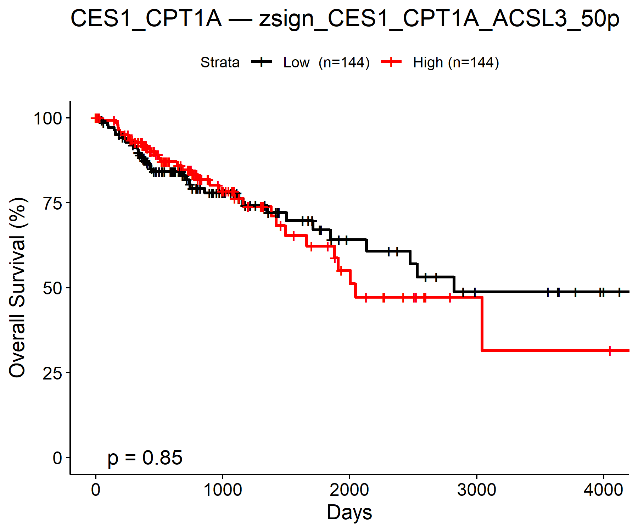
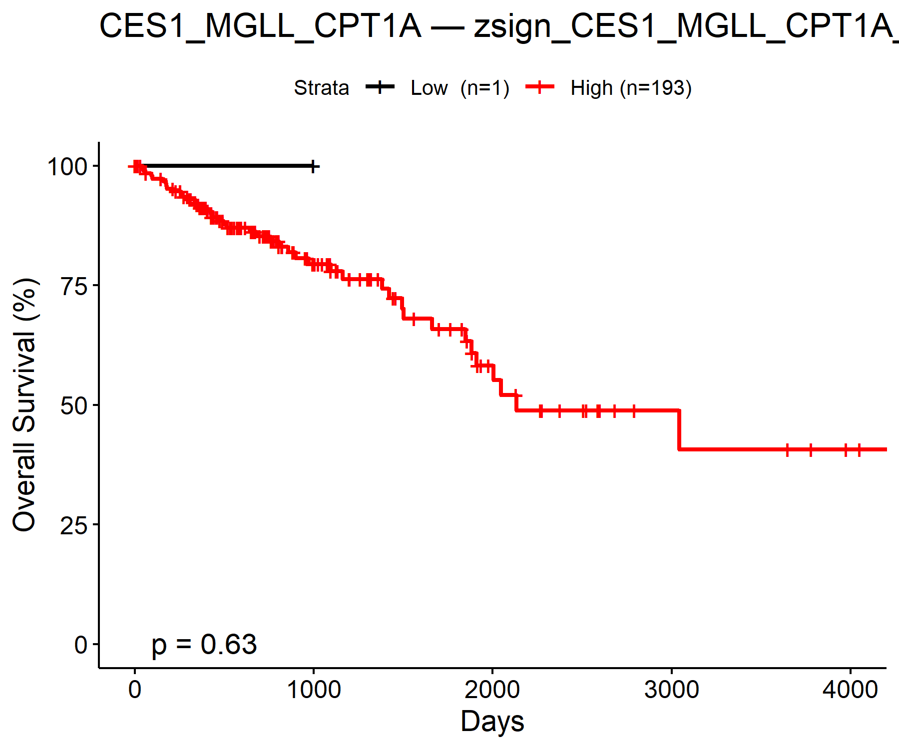
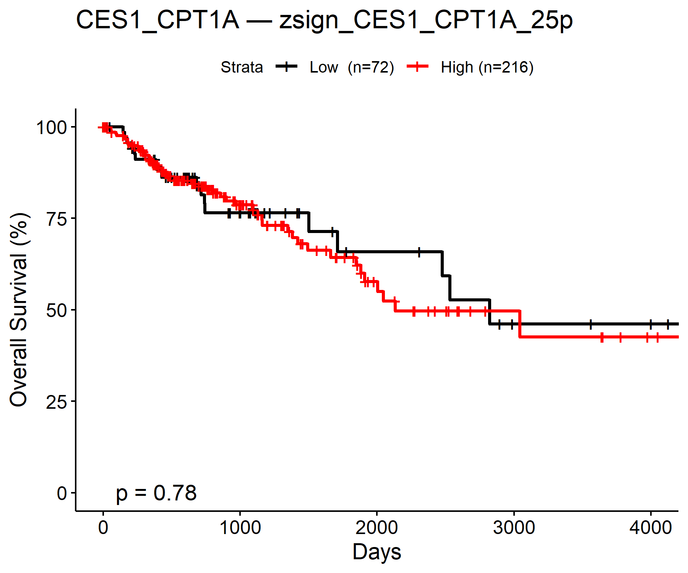
Z-score Normalisation + Signature Scores
Normalised CES1, CKS1B, BIRC5, CDCA5 expression using z-scores
Created multi-gene signatures (e.g. CES1 + CPT1A + MGLL)
Stratified by quantiles (25%, 50%, 75%, etc.)
Defined LOW vs HIGH score groups per signature
Generated survival plots for each signature × threshold
Saved results to: KM_signature_plots folder
Notes:
“Next, I extended the analysis beyond CES1 alone.
First I normalised the expression of CES1, CKS1B, BIRC5, and CDCA5 using z-scores.
Then I created multi-gene signature scores by combining 2–4 genes — for example, CES1 + CPT1A + MGLL.
These composite scores were stratified into quantile-based groups to define LOW vs HIGH.
Survival plots were generated for every signature–threshold combination and saved to the KM_signature_plots folder.
As shown here, not all combinations produced strong effects, especially where group sizes were very uneven.”

Slide 6
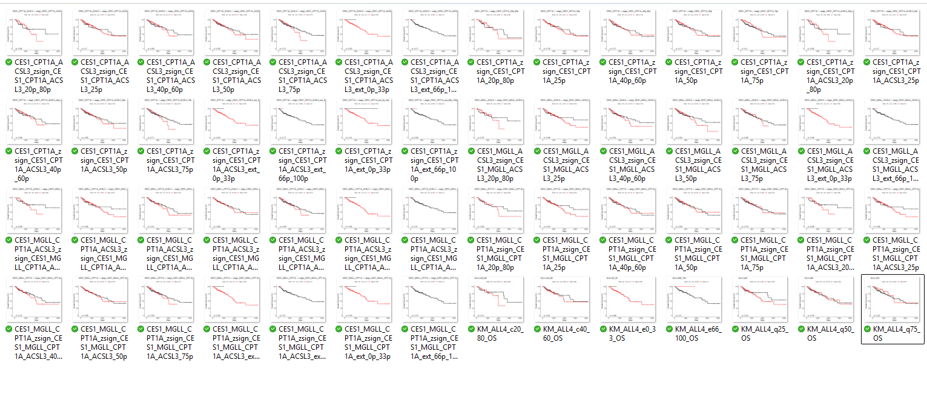

Signature automation & pipeline improvements
Wrote reusable R functions (z-scores, signatures, KM plots)
Looped across genes and thresholds
Auto-saved outputs with smart filenames
Cleaned structure → fewer manual edits
Plots saved to: KM_signature_plots
Notes:
“In the final stage, I streamlined the workflow by turning repeated code into reusable R functions — including for z-score scaling, signature generation, and KM plotting.
I used loops to apply these functions across all gene combinations and stratification thresholds.
Each output was saved with an informative filename to help with traceability and folder organisation.
This cleaned structure meant fewer manual edits and made it easier to reuse code across new gene sets or cancer types later.
All plots here were generated from those automated scripts and saved into the KM_signature_plots folder.”

Slide 7
Issues I Faced & How I Solved Them
Sample IDs didn’t match across expression and clinical datasets → Fixed by removing ENSEMBL version suffixes and matching correctly
Some survival plots were using the wrong (unfiltered) clinical data → Resolved by subsetting to primary tumors only
Looped plots were saving in the wrong folder → Created dedicated folder: KM_task2_looped_thresholds
Too many combinations to run manually → Automated gene signature generation, thresholding, and saving
Notes:
There were quite a few technical issues I ran into during this process.
First, the sample IDs didn’t match across the expression and clinical datasets — I realised that ENSEMBL version numbers were the problem, so I removed those suffixes and matched cleanly.
Second, I noticed that some survival plots looked off — turns out I was accidentally using unfiltered clinical data instead of just primary tumour samples. I fixed this by properly subsetting with the sample type file.
Then when testing loops, I found that plots were saving into the wrong folder — so I created a dedicated subdirectory for the task.
And lastly, because there were just too many gene/threshold combinations to handle manually, I automated the whole pipeline — generating signatures, stratifying, and saving outputs in one go.”

Slide 8
Summery
Completed CES1 survival analysis (OS, DSS, PFI)
Expanded to 4 genes and created z-score based signatures
Automated signature generation, thresholding, and plotting
Cleaned dataset merging and filtered for primary tumors only
Organized all outputs into clearly named folders

